Slide 1
Walmart Rental Data Analysis
File created on: 6/14/2022 10:17:05 PM

Slide 2
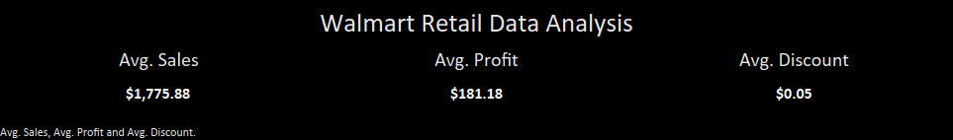

Slide 3
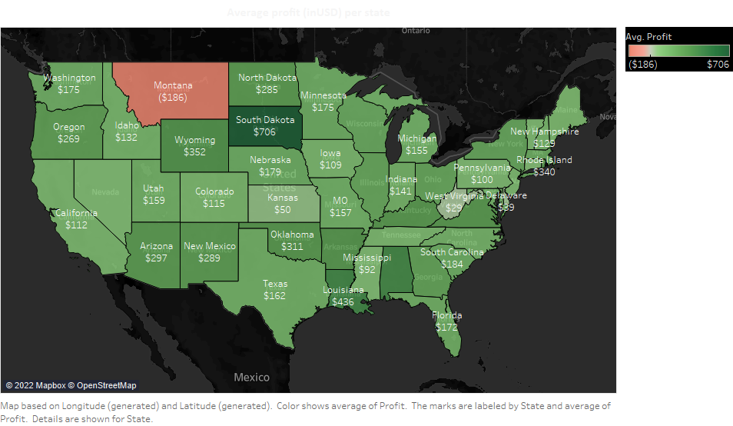

Slide 4
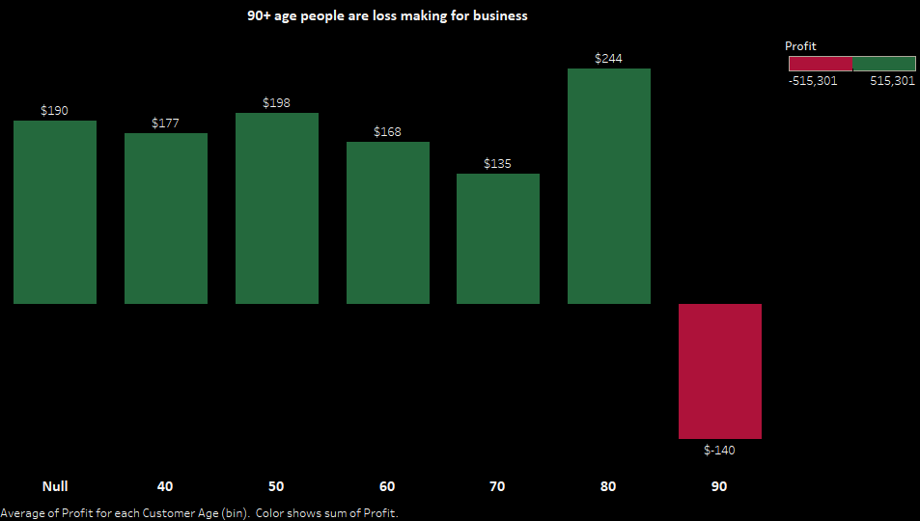

Slide 5


Slide 6
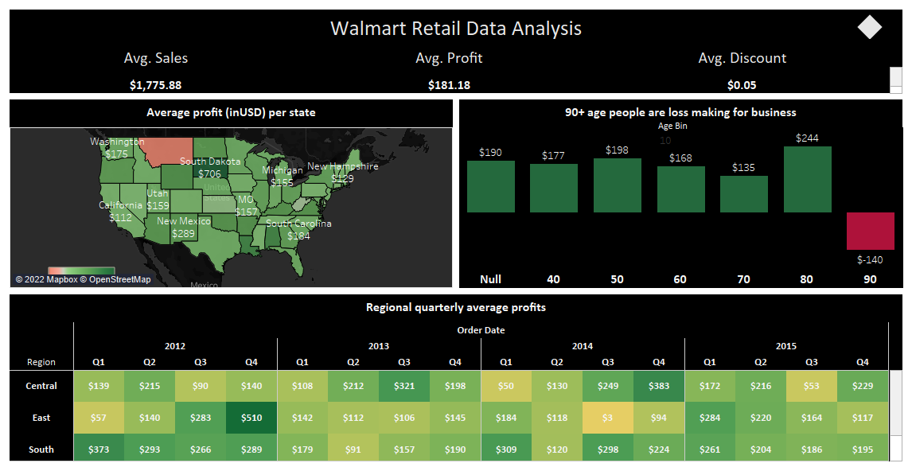

Slide 7
